Slide 1
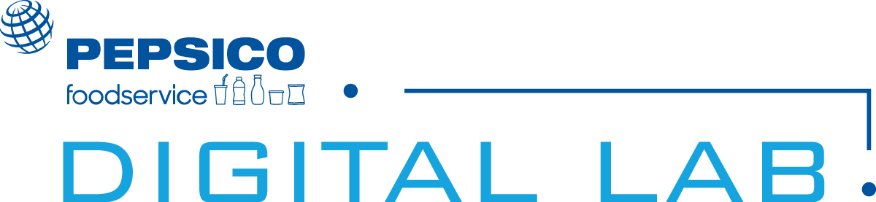


PepsiCo Digital Preferred Partner Playbook: Mobivity
Helping Partners Increase Consumer Frequency, Spend & Loyalty
PEPSICO FOODSERVICE DIGITAL LAB PLAYBOOK | September 30, 2019

Slide 2
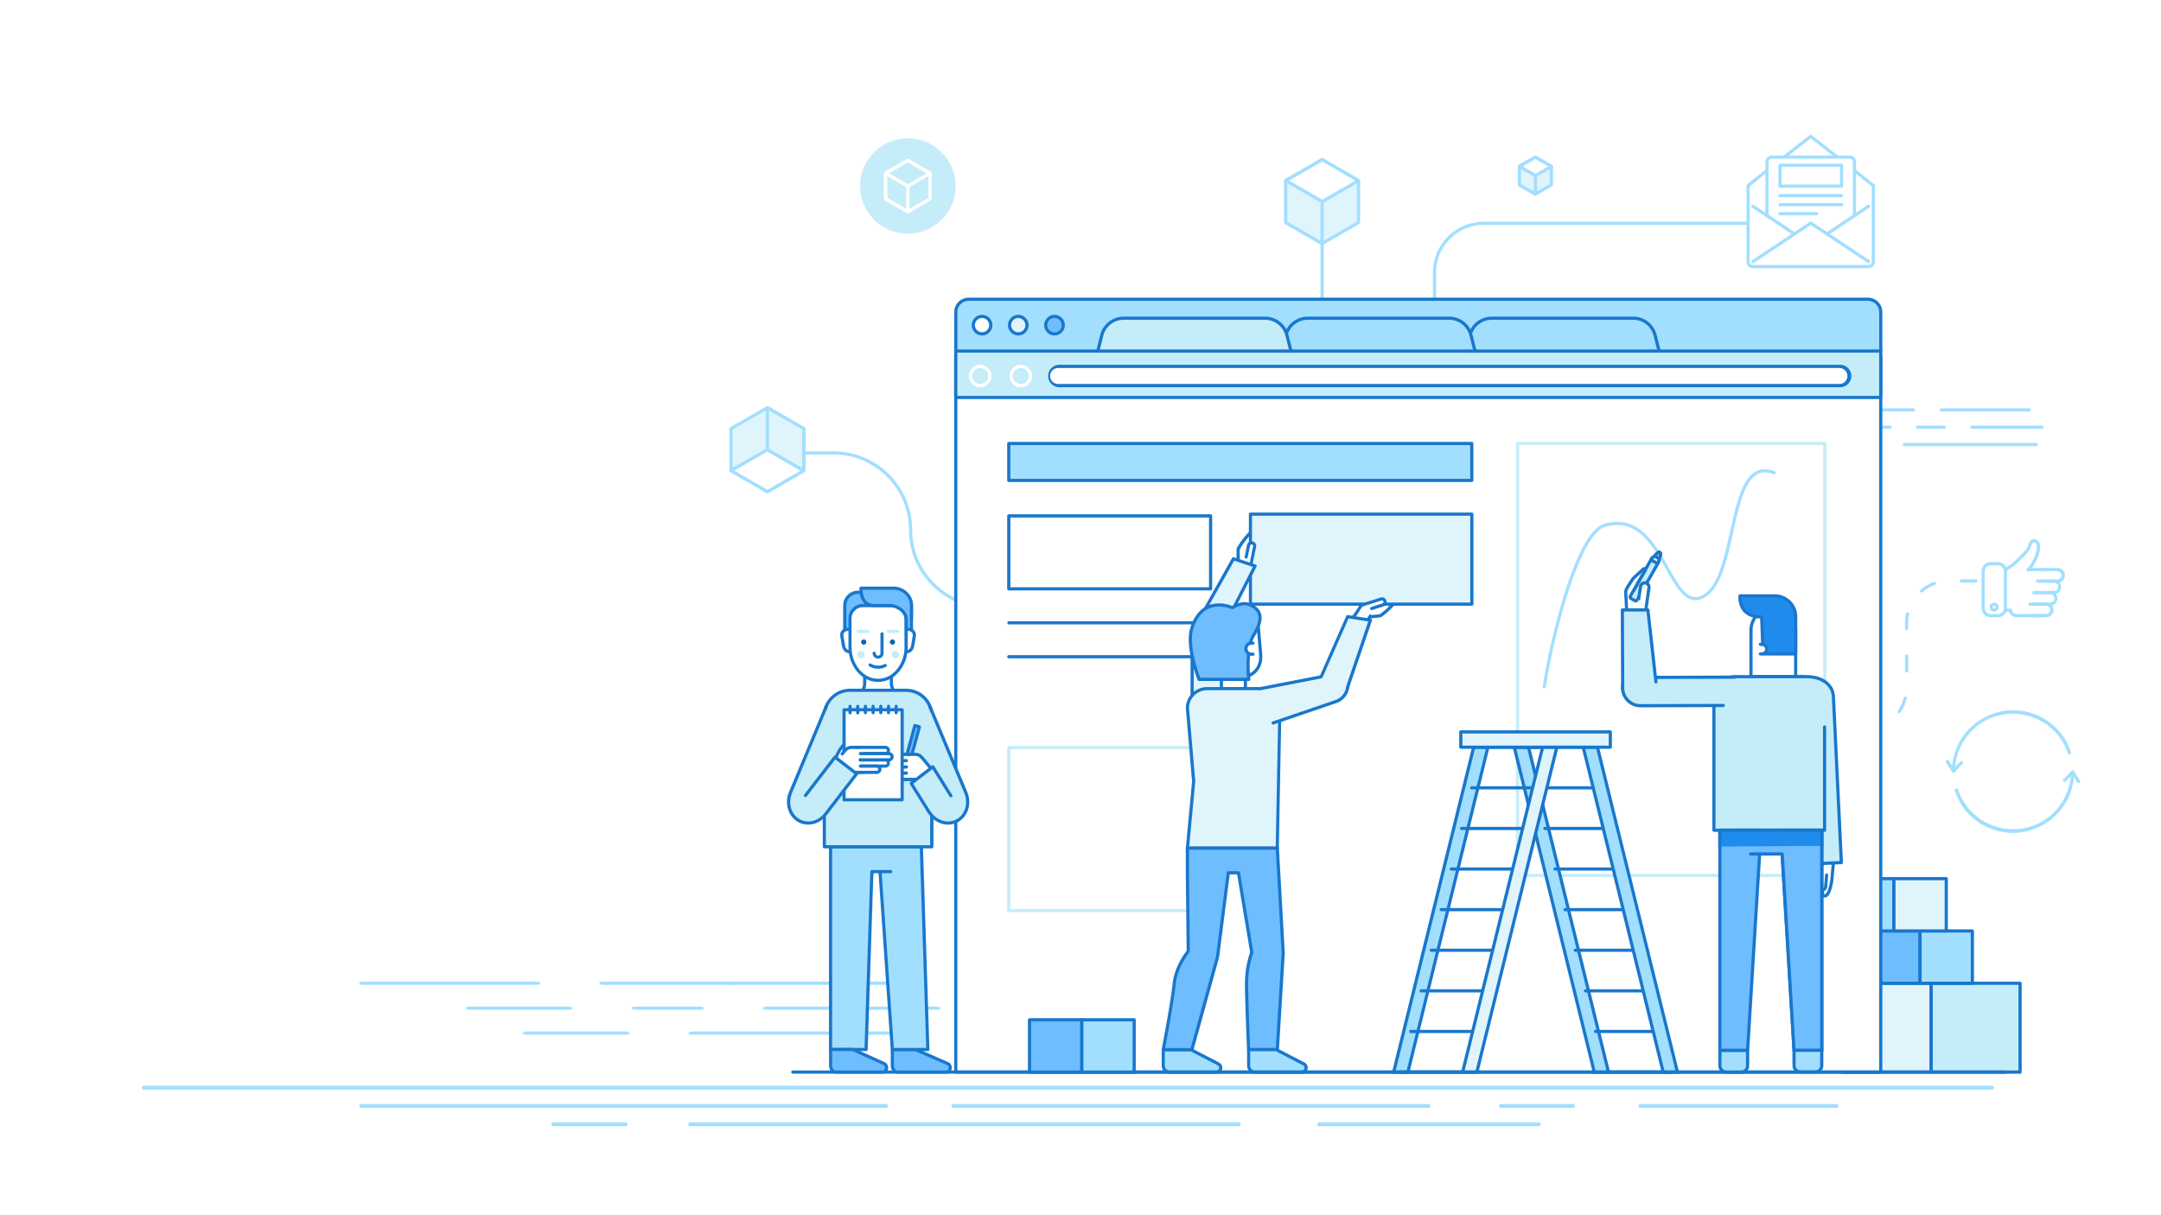
CHALLENGES
YOU FACE
1. Acquiring New Guests
2. Increasing Returning Guests
3. Increasing Spend Per Visit
Notes:
We understand the challenges you face, like attracting new guests, and not only keeping them, but getting them to come back more frequently, and spend more when they do. That’s why PepsiCo Food Services carefully selected Mobivity as part of our Digital Lab as a preferred partner. They are the market leaders in Guest Frequency Management and have helped hundreds of brands increase the guest visits, spend and loyalty.
In this presentation we will discuss solutions that will help address all three of these challenges.

Slide 3

Driving Loyalty Through Beverage and Snack Incidents
Notes:
One of the aspects of Mobivity’s platform that caused us to select them as part of our Digital Labs was their analysis on billions of full basket POS transactions each year, and in their analysis with brands just like you, they a direct correlation between promoting high-perceived value, low cost offers that include a drink or snack with a purchase that drives longer term loyalty, frequency AND increased spend. They have seen this story play itself out in the numbers time and time again. The problem is for you as our partner, up until this point, you haven’t been able to see the true impact of your marketing efforts and dollars.

Slide 4
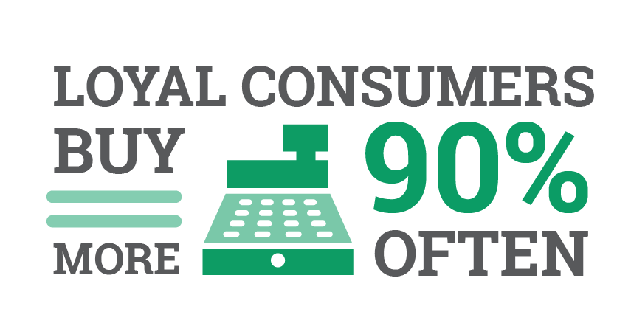
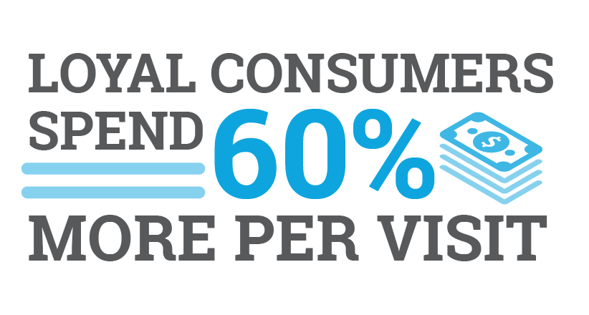
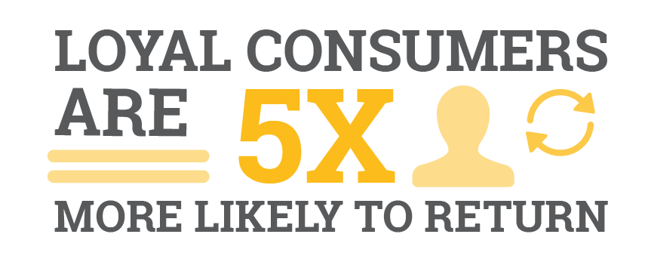
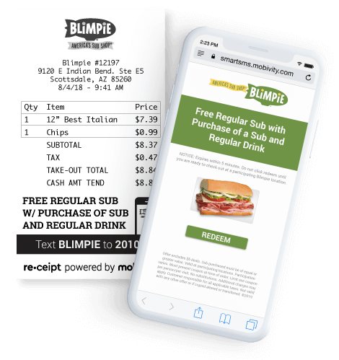
Why is Loyalty Important?
PepsiCo customers like Blimpie Restaurants that deploy Mobivity’s product line have seen up to a 22% increase in drink sales.
Notes:
Take loyalty, for example. A properly executed loyalty program will hit on several key performance indicators, such as buying more often, spending more for every transaction, as well as returning more often than those that are not in the program. The key is knowing which behaviors to reward for loyalty. Most programs are based on rewarding current behaviors, which means you are likely giving away a product to someone who was content with paying full price for the same items. Instead, you need a solution that can take the learning from the billions of analyzed transactions that will make a recommendation that shapes and rewards NEW behaviors. When you do that, you end up seeing remarkable uptick in the frequency and spend of your guests.

Slide 5
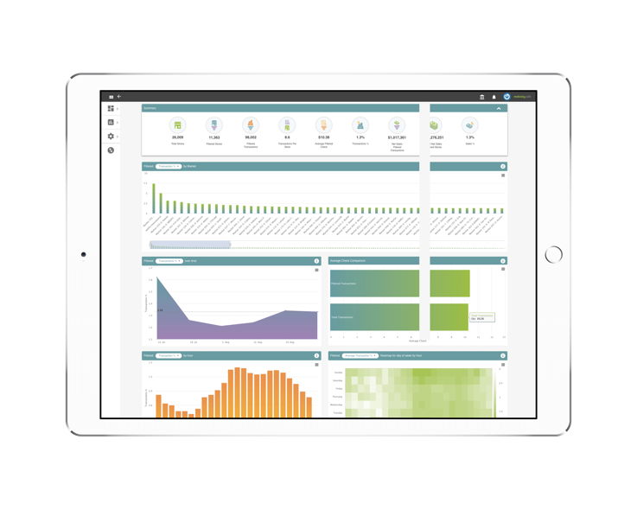
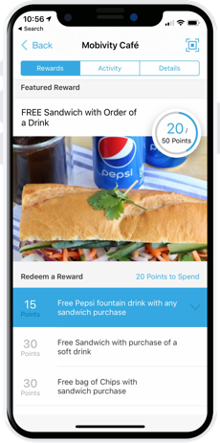
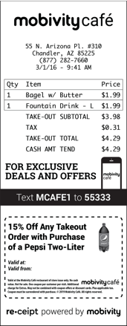
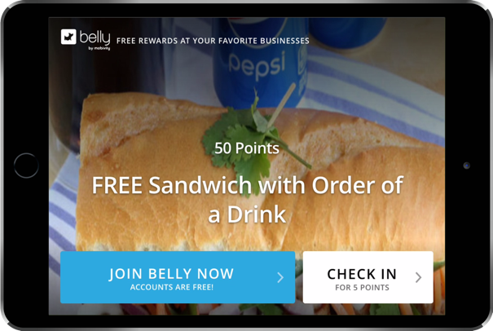
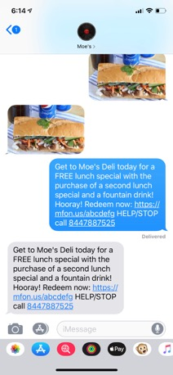
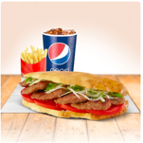



Solutions for All PepsiCo Customers
Mobile Engagement, Receipt Marketing &
Crew Rewards
The End of Punch Card Loyalty
Moe’s Deli
Moe’s Deli
Moe’s Deli
Moe’s Deli
MOES
Moe’s Deli
Best fit for 1-25 Locations
Best fit for 25+ Locations
Notes:
Pepsico Food Services curated our preferred partners selectively in order to provide the best value for ALL of our customers. Mobivity brings our customers multiple solutions that will assist them in solving multiple challenges. The digitization of a paper punch card loyalty program will help our customers earn and keep every guest, providing a simple and valuable program they enjoy. Additionally, Mobivity takes data driven approach to each guest transaction and engagement that they encounter with their favorite brands.

Slide 6

Competitive Analysis
Advantages:
Multi-Channel Engagement
Simple Set-up
No Point-of-Sale Integration Required
Low Investment
Advantages:
Patented Smart Receipt Technology
Point-of-Sale Integration Agnostic
Fully Integrated Omni-channel Approach
Speed of Activation
Restaurant and Service Focused
In-store Tablet Loyalty
Enterprise Loyalty
Text Messaging
Notes:
Mobivity runs up against many different “types” of technology providers across a wide list of offerings. However, there is no other technology provider that can supply everything that Mobivity can with the success we have demonstrated from 1 location all the way to over 30,000 worldwide.

Slide 7
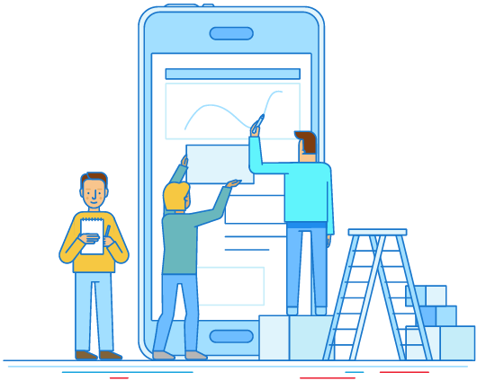
The End of Punch
Card Loyalty
Notes:
You don’t have to be a part of a national or even regional restaurant chain to build a powerful loyalty program that provides value for your guests. We can help you as a small business owner create a program that will provide the capabilities to acquire and keep new guests, run your marketing automatically, and grow revenue.

Slide 8
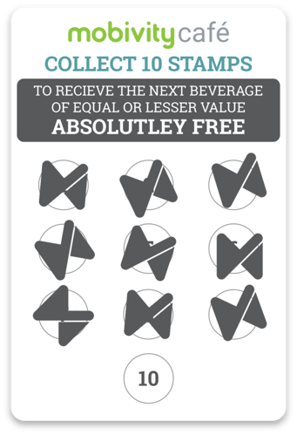
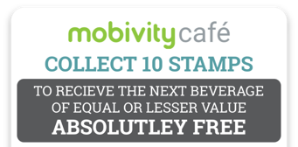




A Revolutionized Digital Loyalty Program
No More Punch Cards Needed
iPad and Mobile Device Based Loyalty
Keep Every Consumer
50% of consumers don’t return. With Belly, collect consumer info after their first visit
to keep them engaged and coming back.
Moe’s Deli
Moe’s Deli
Run Marketing Automatically
Send email and mobile campaigns, without lifting a finger. Grow your social channels and acquire new consumers too!
Increase Revenue Growth
Belly Businesses increase consumer visits
by up to 54%! Drive loyalty while simultaneously bringing in more dough.
Notes:
Turn occasional guests Into regulars. Merchants see customers return up to 54% more often. Easily build a network of loyal customers to drive repeat visits.
Build a digital customer loyalty program perfectly suited for your business. Through the tablet, your customers can easily sign up, check in, and earn points redeemable for their favorite rewards.
Bring back customers automatically, collect and track customer data, engage customers with automatic email campaigns, grow your social presence, and encourage online reviews.

Slide 9


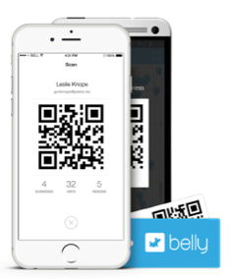
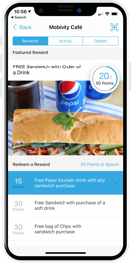
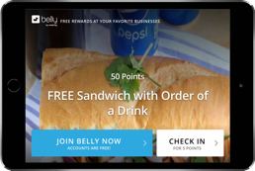
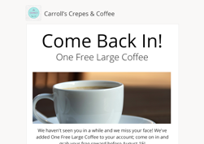
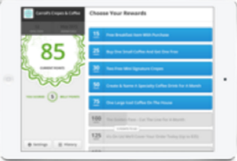
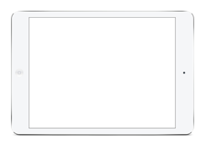
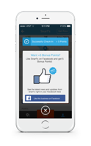
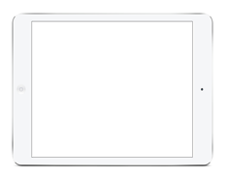
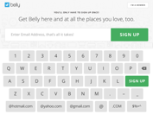
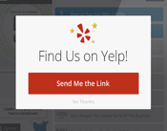
A Belly Consumer’s Journey
Has not returned to deli in 14 days; receives automated email offer.
Tweets about purchase.
Confirms Belly account.
Downloads app to manage points & rewards.
Redeems 85 point reward
Signs up for Belly at local deli on iPad.
Returns to business to redeem offer & make purchase
After 3 visits, leaves a positive Yelp review.
Returns to deli, checks in & makes purchase.
Moe’s Deli
Moe’s Deli
One Free Fountain Drink
0 - 1
2 - 7
8 - 30
31 - 365
Notes:
Here is an example of a Belly member consumer journey you can deploy with Belly quickly and easily to solve a specific challenge you may be facing. Utilizing a cross channel approach with the email marketing driving in-store traffic during down times will not only help you as the small business owner, but also provide great value to your guest – bringing them back more often.

Slide 10
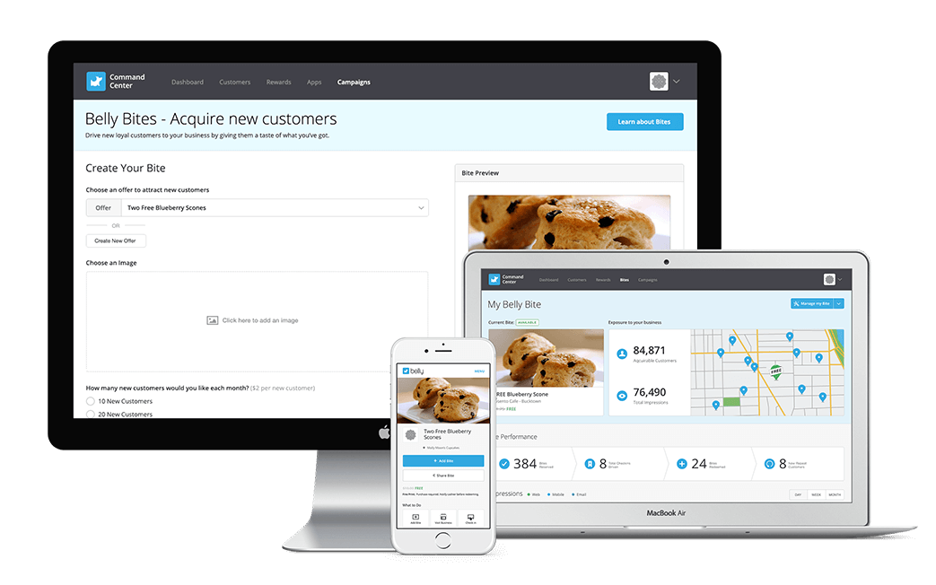

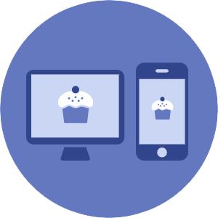

The Challenges You Face: Acquiring New Guests
Using Belly Bites to Acquire New Guests
Create: Belly Bites is a way target nearby Belly members with a strong offer to attract new guests into your business —Show off what you’ve got, and begin growing your guest list.
Promote: We’ll advertise your Bite to Belly members who haven’t visited your business and send you new guests each month.
Track: See the number of impressions your Bite receives, who visits your business, and how many members became repeat consumers
Notes:
Acquiring new guests can start day one! With our Belly Bite feature your customers can target current Belly Members in close proximity to their locations. Using the Belly platform this new guest offer can be accessed by all Belly app subscribers that are not part of your customers loyalty program already
This means that on their first day they can be promoting to their local portion of Belly’s 2.5 million user base.

Slide 11
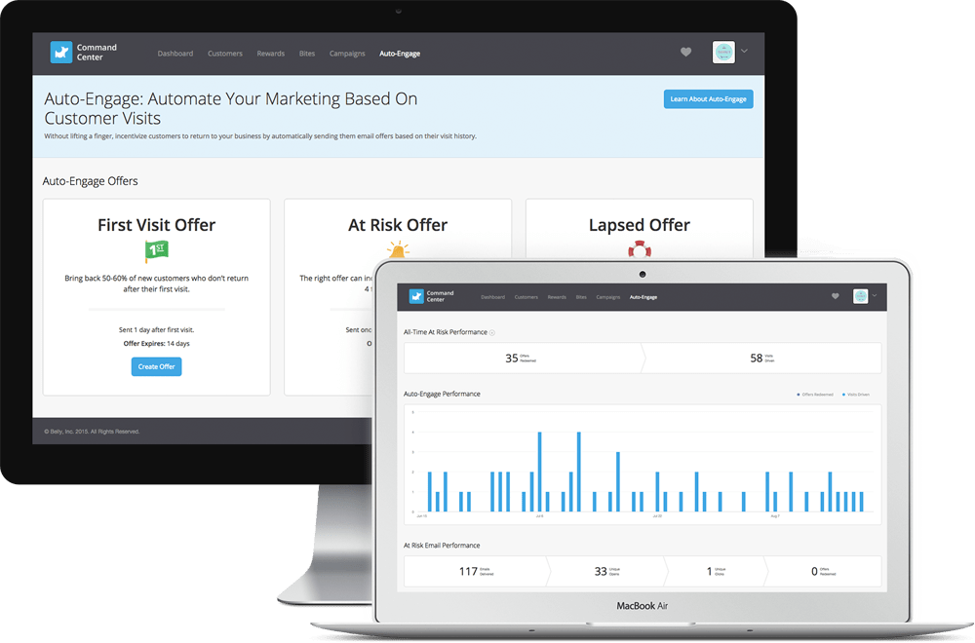

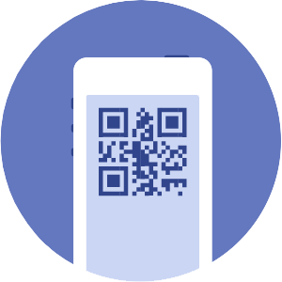

The Challenges You Face: Increasing Returning Guests
Bring Your Guests Back with Auto-Engage
Bring Back Up to 10% of Disengaged Consumers: On average, Operators who run Auto-Engage campaigns see a 28% open rate while re-engaging up to 10% of guests that have reduced visitations.
Turn New Guests Into Loyal Guests: Auto-Engage incentivizes first time visitors to return, ensuring that they’ll become a loyal guests to your business.
Results You Can Track and Understand: Measure how many consumers received your offer, opened your email and visited your business to redeem.
Notes:
Belly gives operators the ability to send outreach emails and mobile push notifications through the official Belly App for events, LTO’s, or Flash offers at anytime. Scheduled email templates can be automatically sent as part of the Belly program. This can deliver new guest offers to gain a future visits, as well as engage any guest that has not visited for 30, 60, and 90 days.

Slide 12
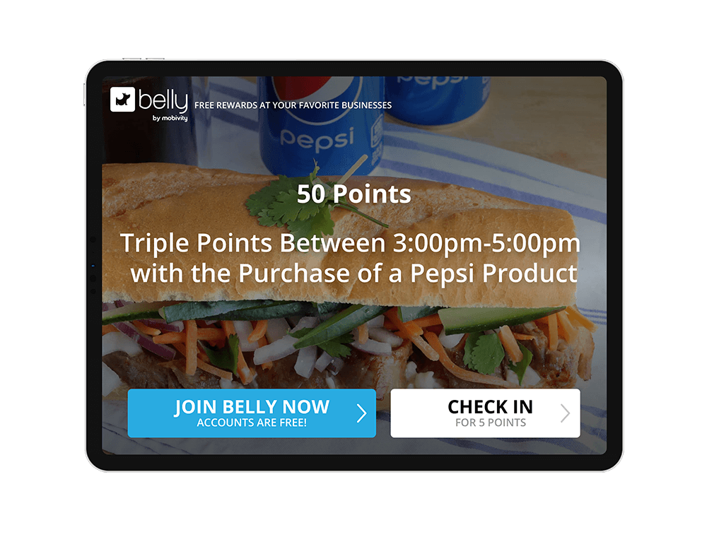
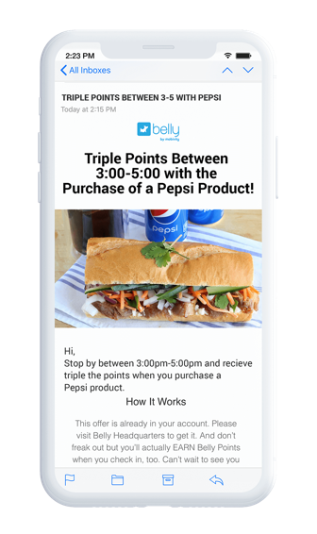
The Challenges You Face: Increasing Spend
Loyal guests spend 60% more per transaction
Multi-Method Engagement: Send loyal guests targeted messaging with special offers through email, mobile push messages, and more
You Control the Offer: Increase your consumers order sizes with valuable rewards to surprise and delight. Track their success and optimize.
Increase Mid-Day Traffic Lows: Rewarding guests with valuable offers and points to increase spend during day and week parts.
Notes:
Increasing guest frequency is only the beginning of the loyalty equation. Getting those consumers to spend more every time they visit is equally important. Belly can support this through several methods that will also help increase beverage incidents on more transactions. An example of this is to use Belly point rewards multipliers during slower windows of time or days. Using the Belly app, email templates and historical reward reports to gain higher participation on days you want more guest in your location.

Slide 13
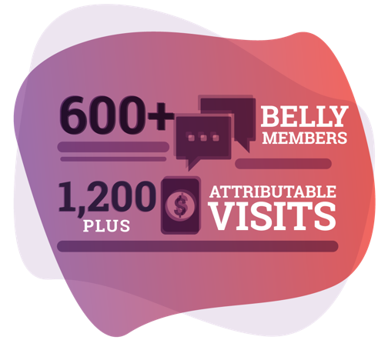
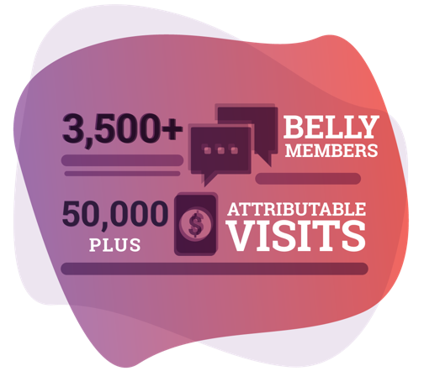

Driving Results with Belly
3 Locations
1 Location
Activating a first-visit offer incentive, consumers who were enrolled visited an average of 45% more in a 1-month period, and came back twice as fast, driving 178 visits in that month.
Increased consumer visit frequency by 15%. Before Belly, consumers visited an average of 14.6 times annually.
After Belly, this increased to 16.8 visits per year.
Notes:
Belly has been proven to provide success for thousands of independently owned small / medium sized businesses. Creating loyalty at single locations such as YoFresh or Capital City Cheesecake, or even individual operators of a larger franchise model.

Slide 14

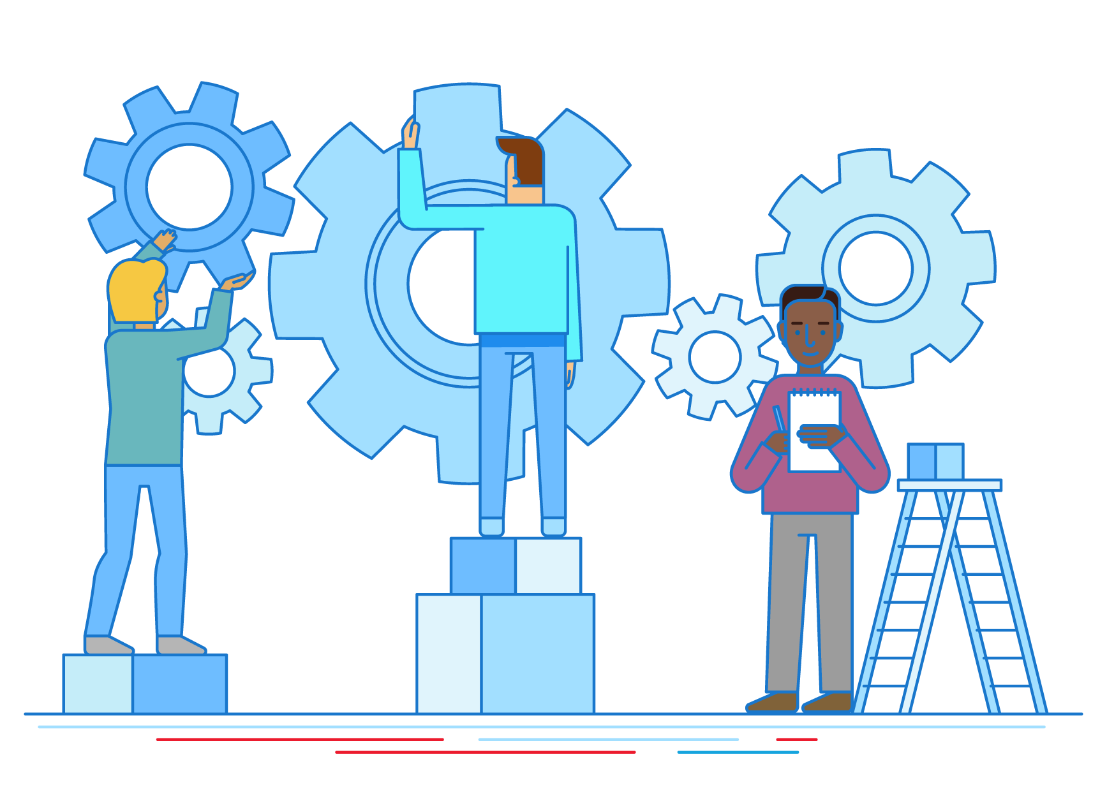
Mobile Engagement,
Receipt Marketing
& Crew Rewards
Notes:
Recurrency provides a holistic solution that a regional or national restaurant operator would need to drive incremental guest visits, increased spend, and the development of true guest loyalty. Mobile Engagement, Receipt Marketing and Crew Rewards can all be utilized collectively to further engage with your guests and get them coming back more often.

Slide 15
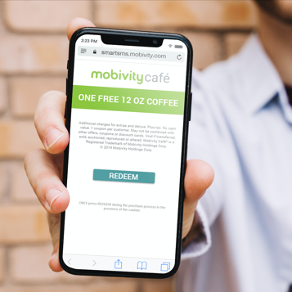
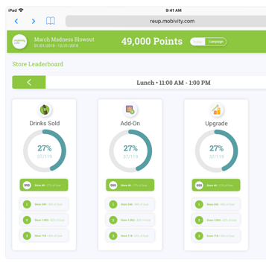
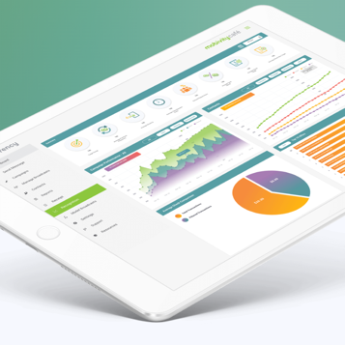
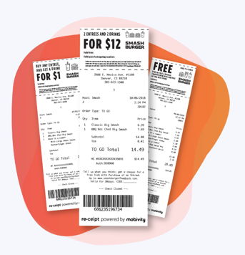
A Consumer Frequency Management Platform
Understand/Activate Data
Mobile Engagement
Crew Rewards
Receipt Marketing
Notes:
Improving guest engagement and frequency requires identifying actions taken that trigger behaviors leading to a purchase, transactional and loyalty data contained in an order, and insights derived from mapping actions to transactions. Recurrency is a data-driven frequency management platform that allows PepsiCo customers to easily access and activate consumer data in one place. Delivering engagement through mobile messaging and utilizing the receipt for promotion and support messaging opportunities.

Slide 16
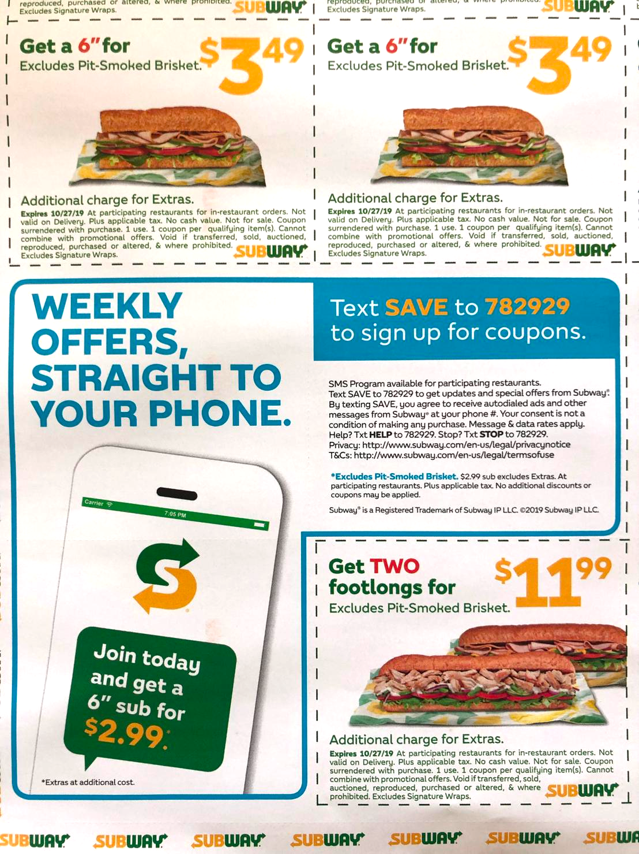
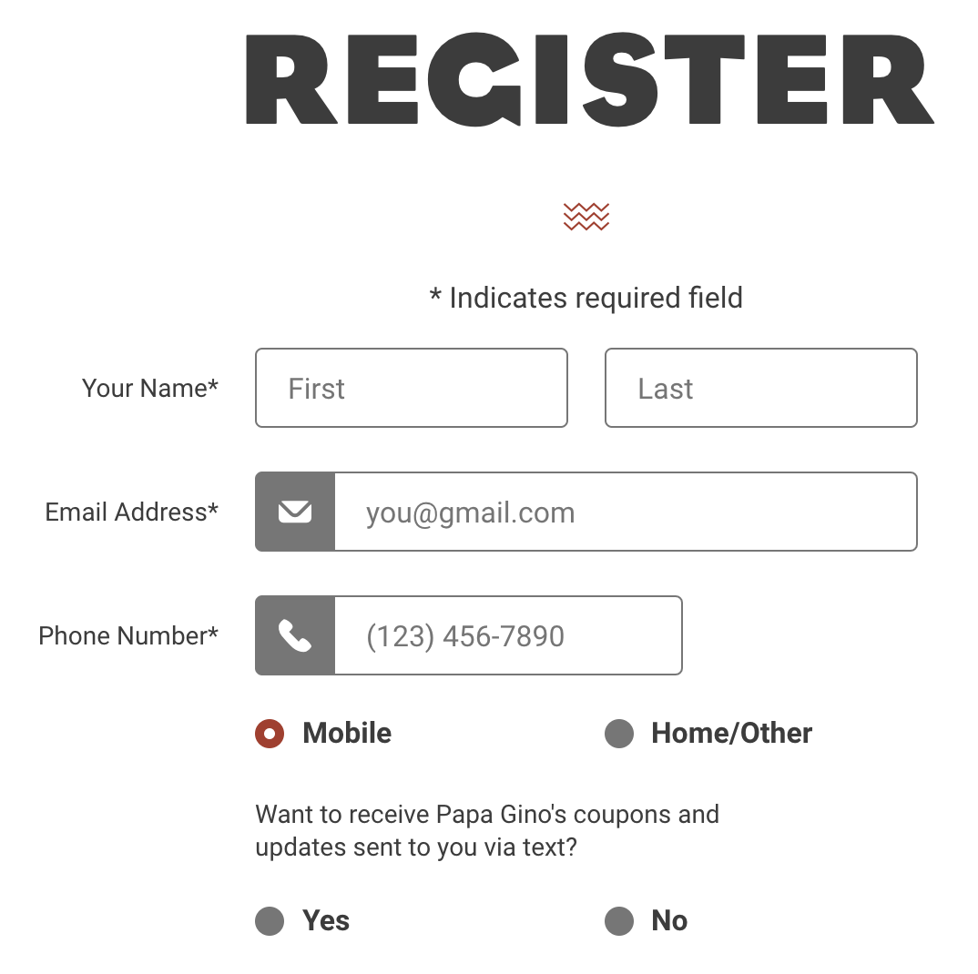
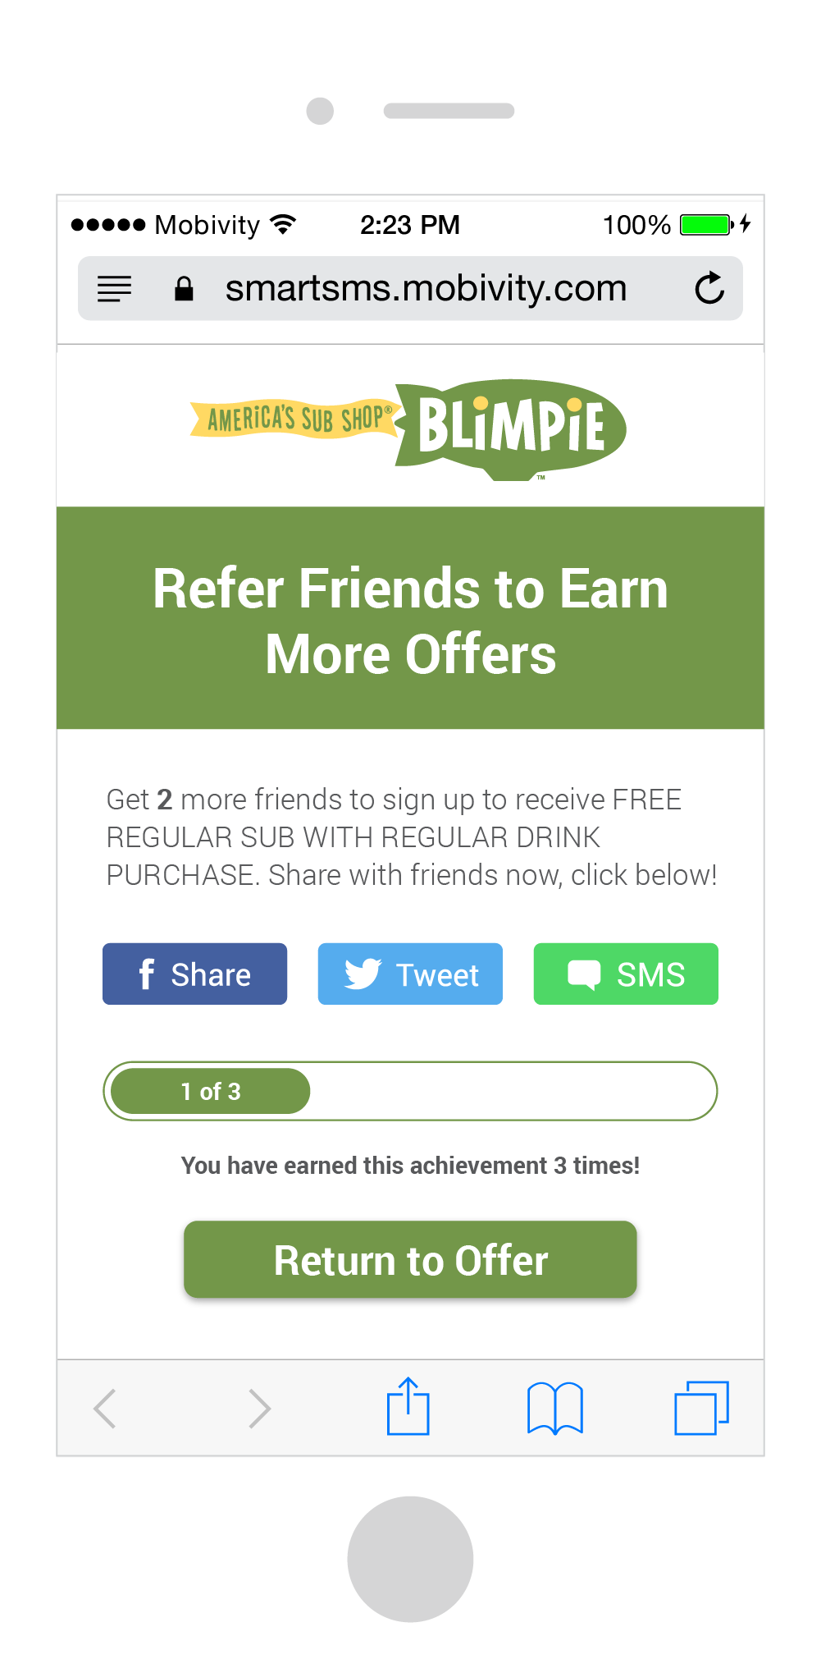
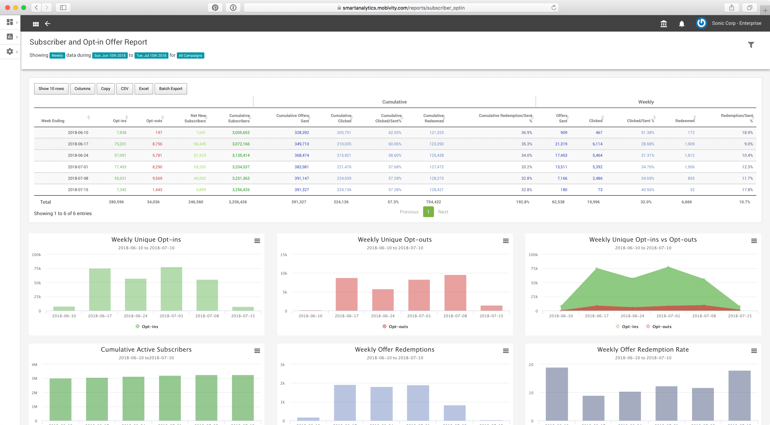
The Challenges You Face: Acquiring New Guests
Tracking ROI on New Guest Acquisition
All marketing methods used to acquire guests can be measured and optimized for true ROI over time by:
Measuring consumer opt-ins from all marketing efforts – TV, FSI, Online Registration, in-store marketing, packaging, and more.
Refer-a-Friend for your messaging program.
Provide a valuable opt-in text message offer to capture guest interest.
Notes:
All marketing activity and methods can and should be supported by text message marketing. There are many ways to drive acquisition of new loyal guests that will extend the life of all marketing efforts. Through Recurrency your customer can acquire interested guests through call-to-actions on TV advertisements, FSI’s, and even their product packaging.
Refer-a-Friend is also a terrific way to extend the value for all of the existing loyal customers, as well as building an opt-in list that will continue to grow organically.

Slide 17


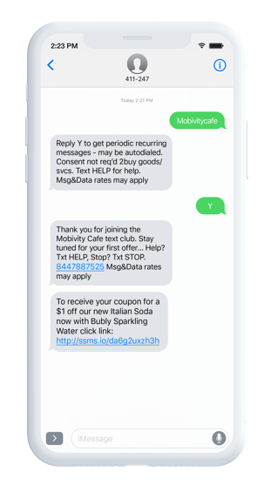
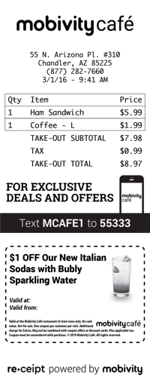


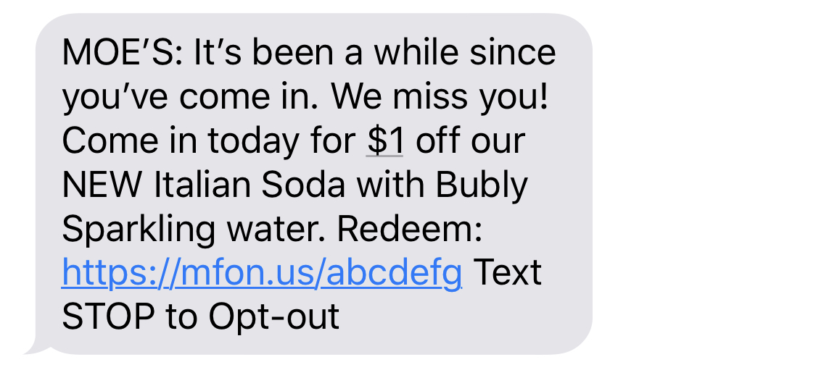
The Challenges You Face: Increasing Returning Guests
Planning for Guest Retention
When a guest stops visiting, you need to be able to reach them and get them re-engaged:
Build and send segmented text campaigns based on guest’s last visit, redemption, or online order.
Send relevant and personalized messaging based on guest profiles and their activity.
Last Redemption
30 Days Later
Notes:
Within the Recurrency solution, your customer can access offer redemption reports to further analyze and derive insights on guests visits, redemptions, and engagement. Utilizing this type of analysis, your customers can target and engage with guests based on last visit, offer redemption history, and other available criteria. This will also allow for your customers to offer the right level of discount or incentive based on guest activity and buying patterns.

Slide 18
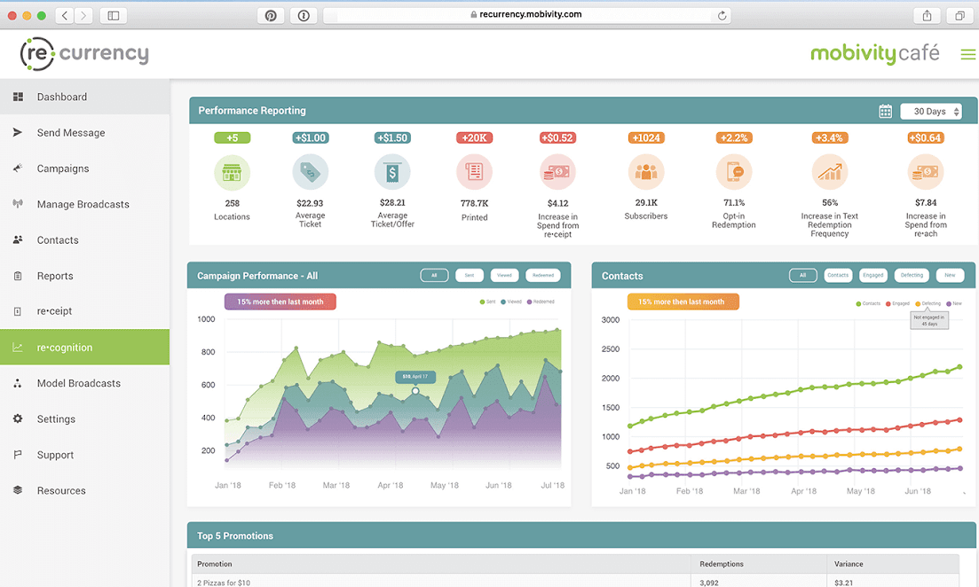
The Challenges You Face: Increasing Spend Per Visit
Encouraging Beverage Incident Growth
Knowing buying behaviors and having an easy way to communicate with your guests supports beverage incident growth in many ways, including:
Promotion of new products and LTO’s.
Driving traffic during dayparts that are typically not as busy.
Increasing order size through the promotion of combos, as well as online and catering orders.
Moe’s Deli
Moe’s Deli
Moe’s Deli
MOES
Moe’s Deli
Notes:
Many times your customers have the desire to promote offers that lead guests to try new products, come in at slow times of day, or increase order size. Promoting Pepsico products and combo deals through text message and receipt marketing opportunities will create a mutually beneficial business relationship between Pepsico and your customers.
Recurrency will also allow for your customer to report on how these offers and outreach campaigns perform to refine offers and to review increase in average visit spend over time

Slide 19


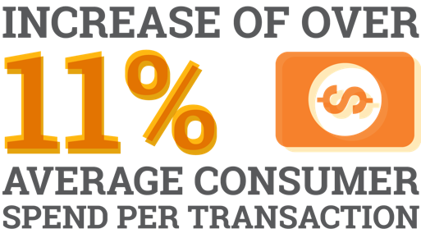

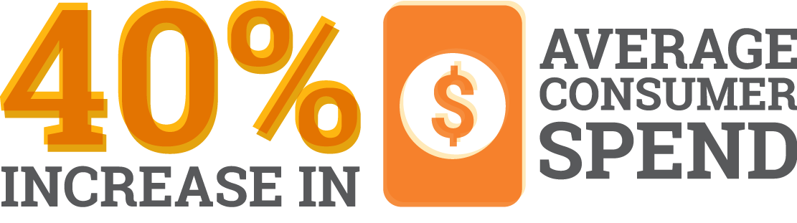
Driving Results with Recurrency
232 Locations
400 Locations
Notes:
Blimpie and Round table have been customers for over a year that stemmed from Pepsico rep introductions. Within Blimpie, all of their locations are utilizing the text message solutions and 57 of which utilize both our Receipt products to engage pre and post purchase. Round Table has seen tremendous results over the past year utilizing only the text messaging solution to drive new and existing guests in and increase there overall order sizes.

Slide 20
How Can Mobivity Support?

Slide 21
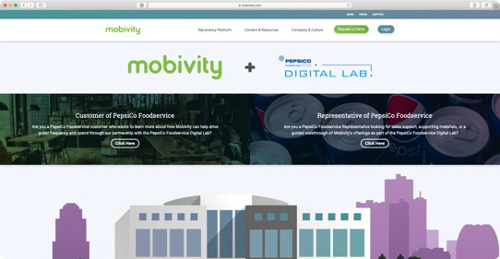
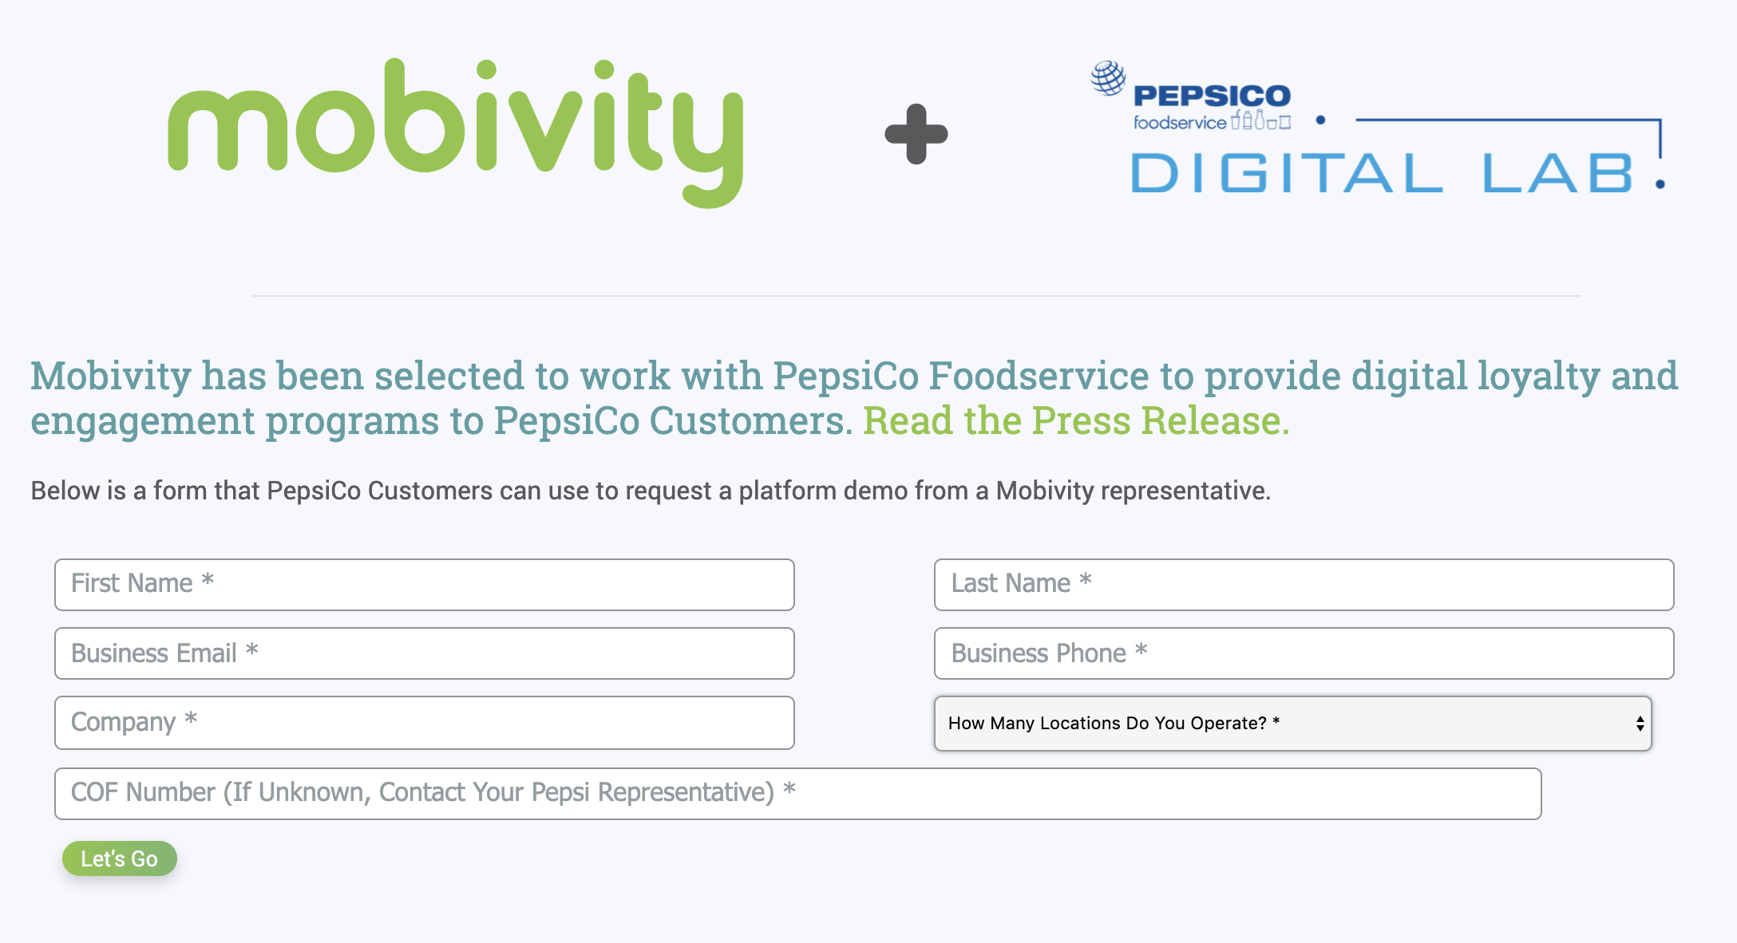
Unlocking Pepsi Preferred Pricing in 3 Easy Steps
1
2
3
Visit mobivity.com/pepsi
Click into the Customer section and fill out the form.
A member of the Mobivity team connect immediately!
Notes:
Getting in contact with Mobivity to get started is extremely simple. Either the Pepsico rep or your customer can access the form to request for a Mobivity representative to get in contact. Mobivity will be in touch in less than 24 hours to discuss how we can help find the perfect solution for your operators and their challenges. Additional support can also be requested, such as joint meeting attendance, 1:1 demonstrations, or complete customer care with your customers after introduction.

Slide 22

PepsiCo Digital Preferred Pricing
PepsiCo partners receive a discount between 23% and 60% on Mobivity’s Belly and Recurrency platforms. These discounts are reflected in the pricing below.
Discount for Pepsi Partners
Product Offering | 1-50 Locations Cost is Per Location Per Month | 51-100 Locations Cost is Per Location Per Month | 101-500 Locations Cost is Per Location Per Month | 501-1000 Locations Cost is Per Location Per Month | 1,000+ Locations Cost is Per Location Per Month
Full Recurrency Bundle | $200 | $180 | $165 | $145 | $115
Recapture POS Data Intercept | $50 | $45 | $40 | $35 | $30
Receipt Receipt Ad Targeting | $100 | $95 | $90 | $75 | $60
Reach Mobile Marketing | $60 | $55 | $50 | $40 | $30
Reup Incentivize Employees | $99 | $90 | $85 | $75 | $60
Belly Digital Loyalty | $99 | $90 | $85 | $75 | $60
* Preferred Partner Pricing available only to existing PepsiCo Foodservice customers.
Notes:
Through Pepsico Digital Labs, you are eligible for the Preferred Pricing with Mobivity as a carefully selected partner.

Slide 23
Thank You!
PEPSICO FOODSERVICE DIGITAL LAB PLAYBOOK | September 30, 2019

