Slide 1
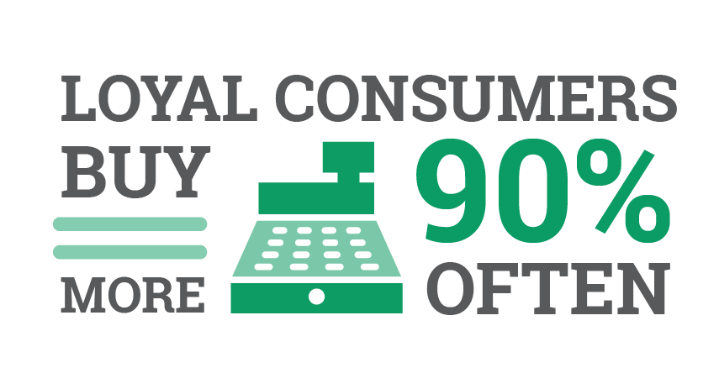
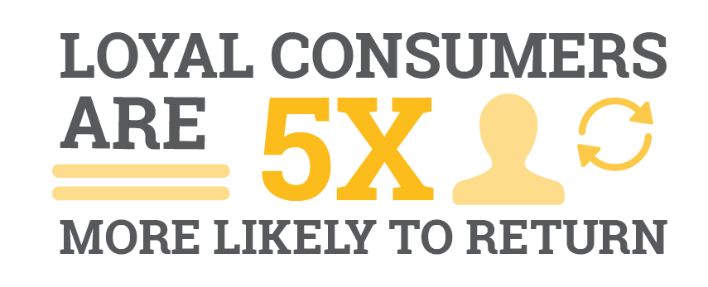
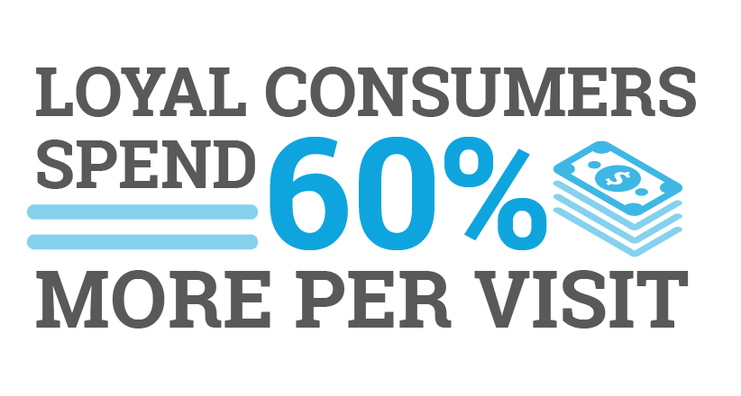
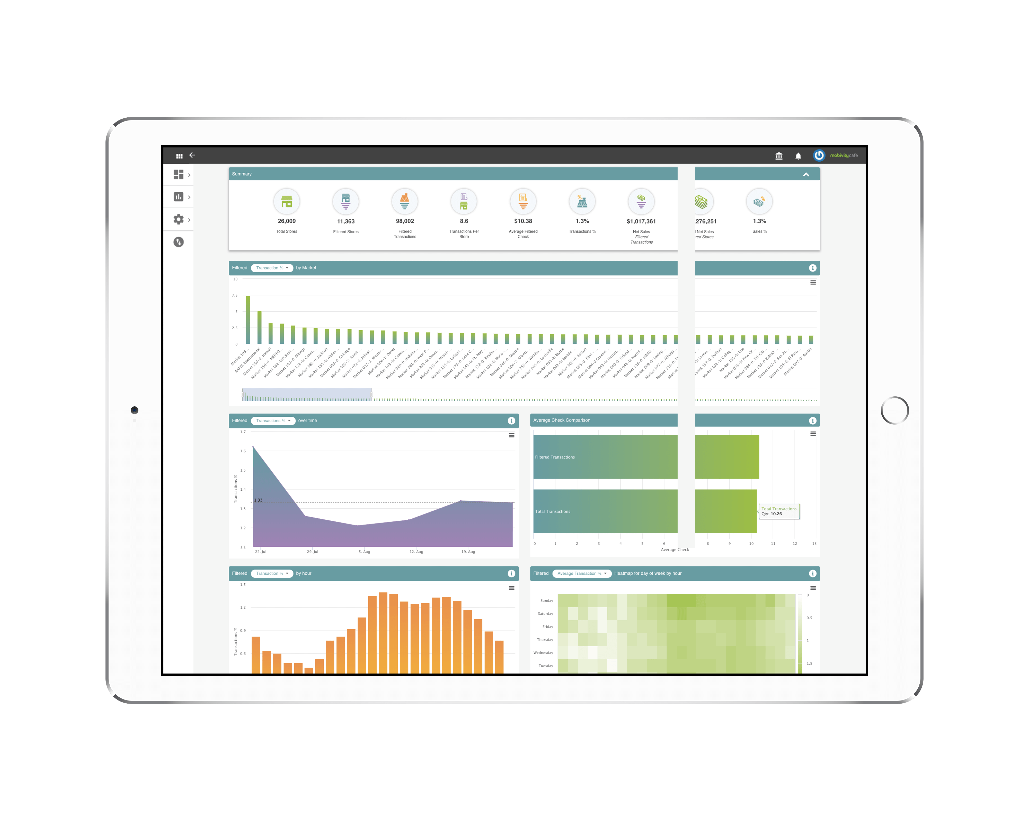
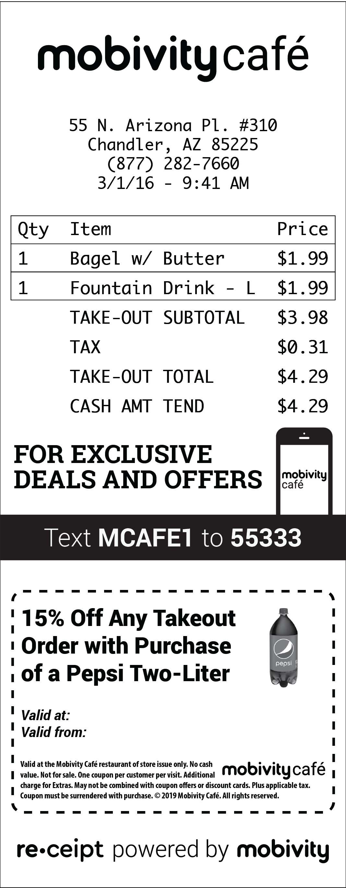
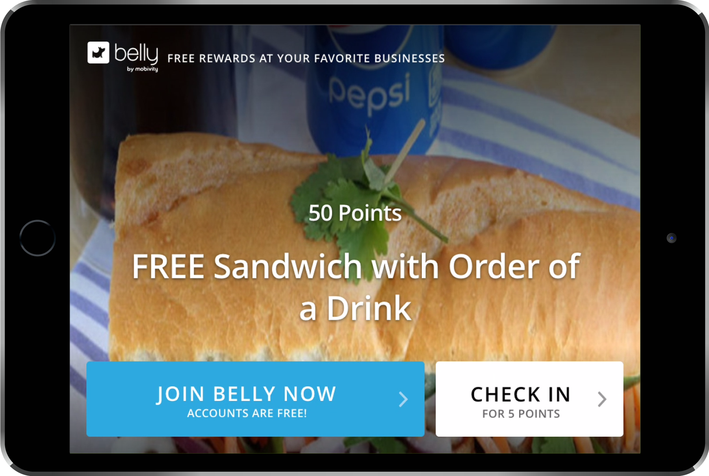
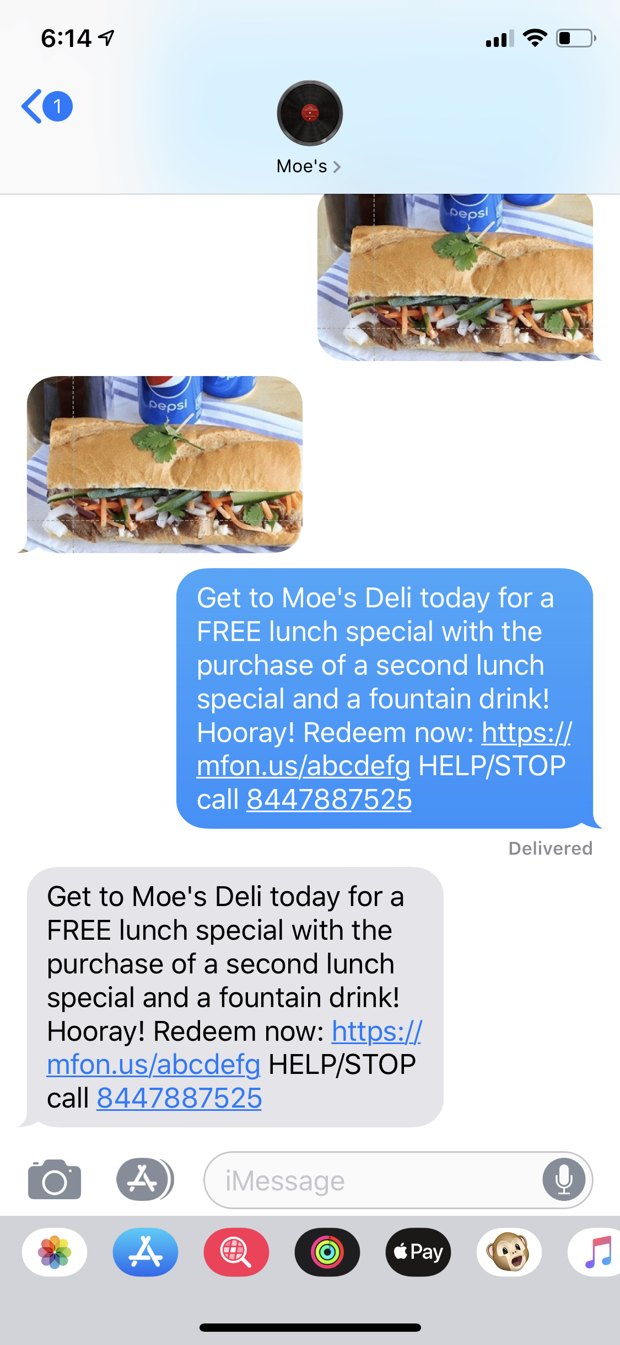
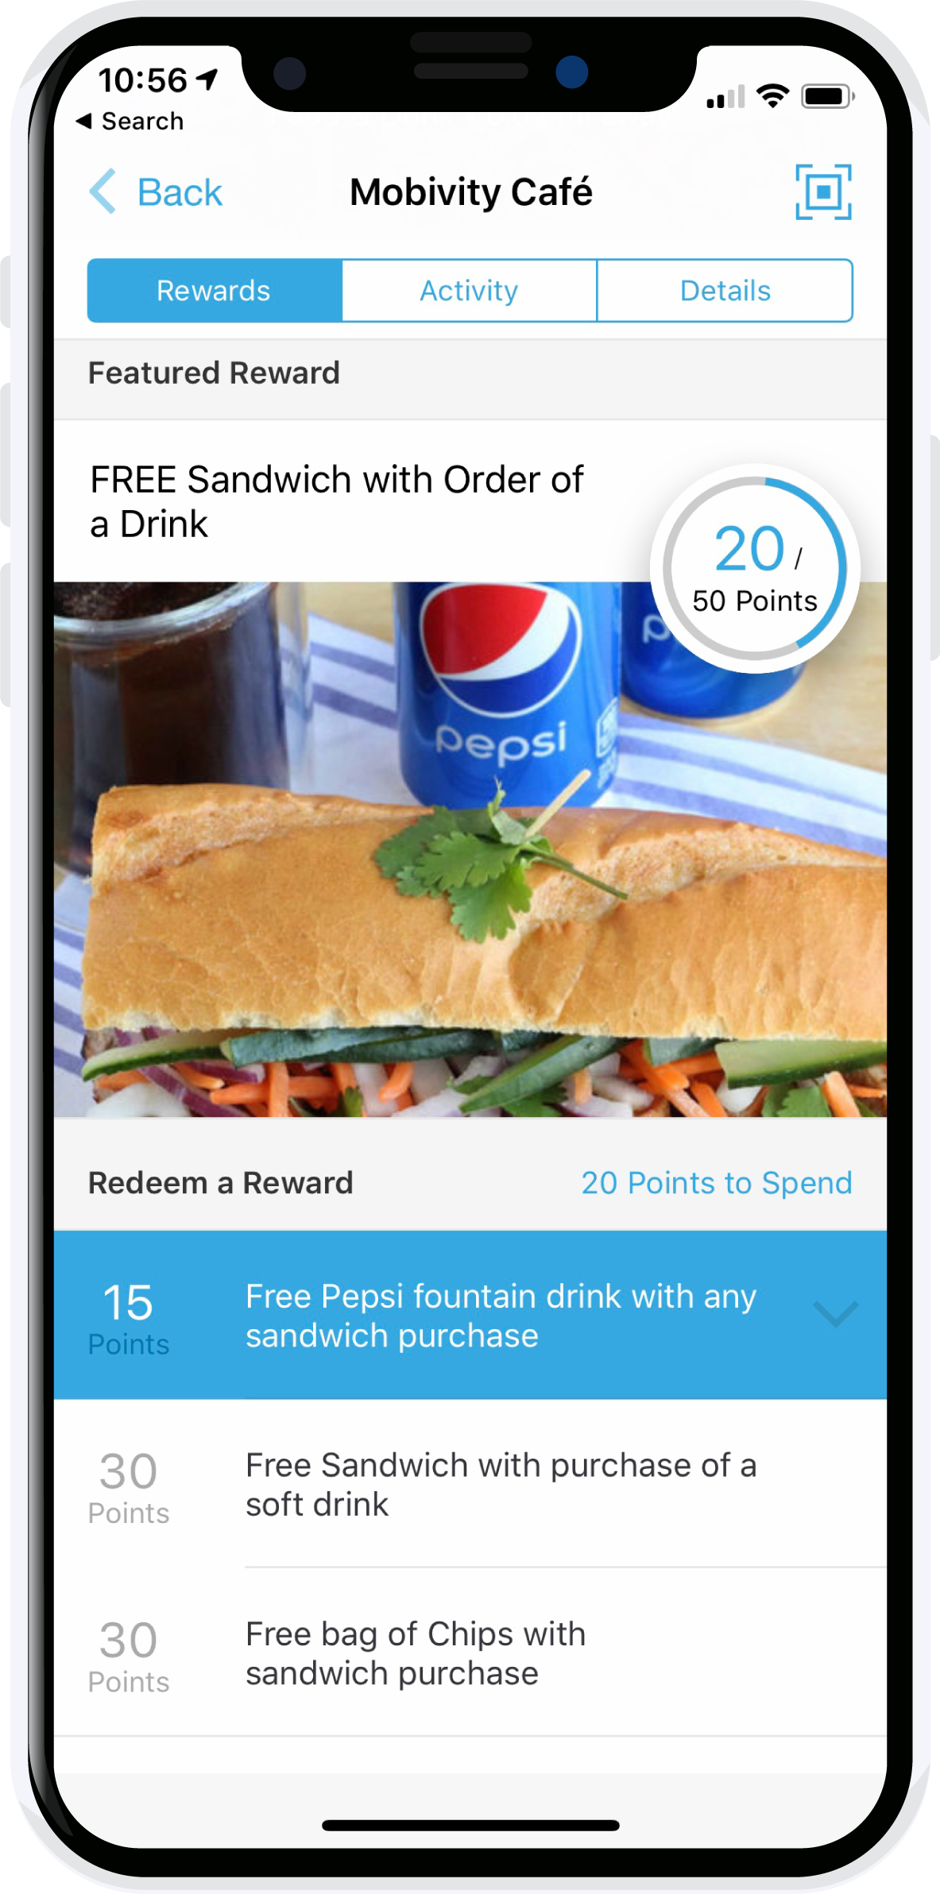
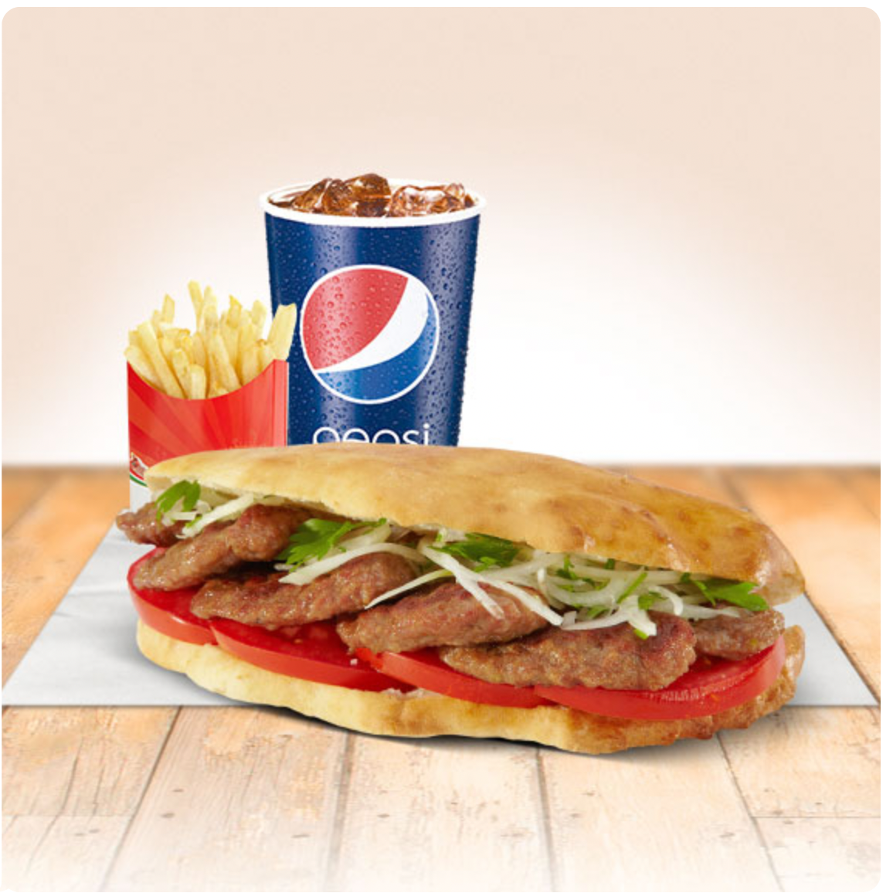
Increase Consumer Visits, Check Size, and Loyalty
The End of Punch Card Loyalty
Moe’s Deli
Data Driven
Mobile Marketing & Receipt Offers
Moe’s Deli
Moe’s Deli
Moe’s Deli
MOES
Moe’s Deli
Unlock PepsiCo Preferred Partner SAVINGS today! Learn more at mobivity.com/pepsi

